Slide 1
Object Design Review
Group 5: Marissa Morton, Miguel Gapud, Alex McNair, Abram Miller, Michael Zuppardo

Slide 2
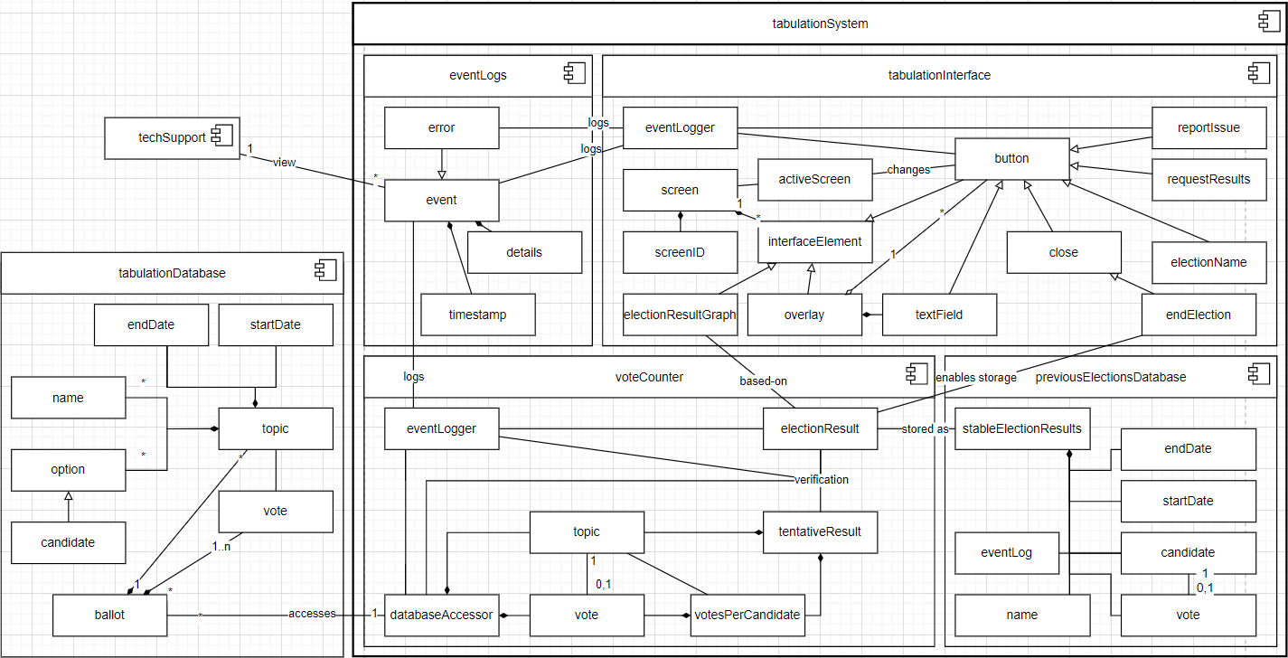
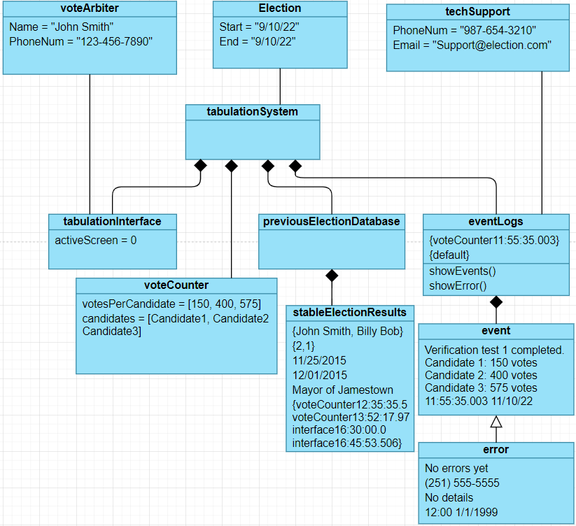
Breakdown of tabulationSystem

Slide 3
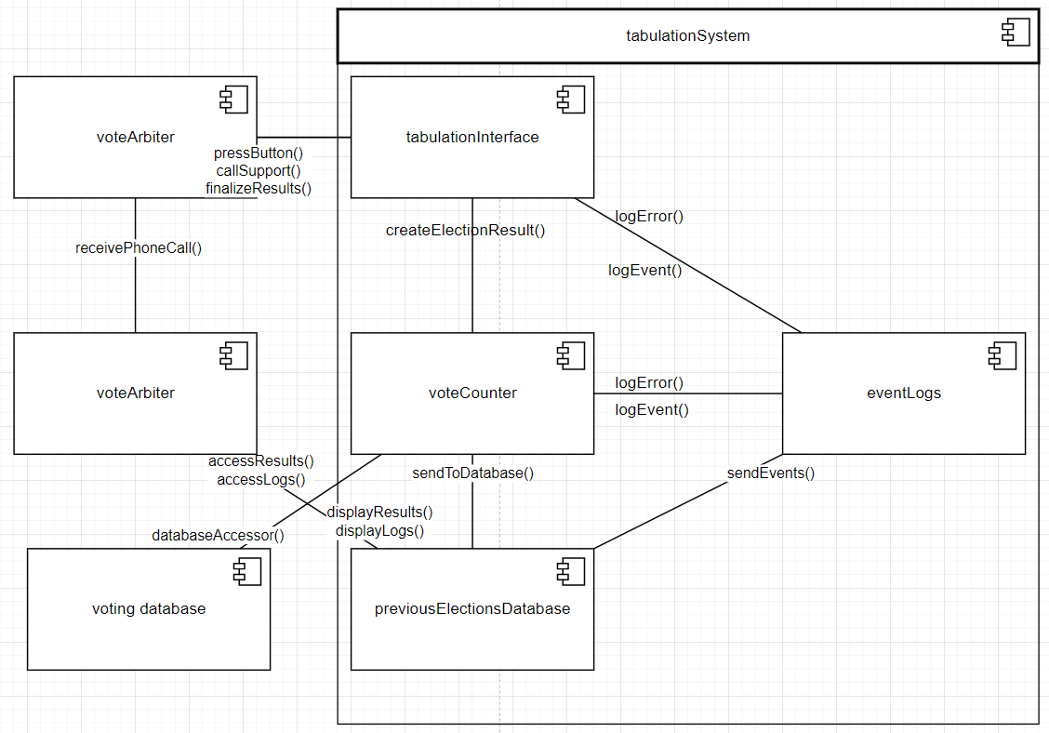
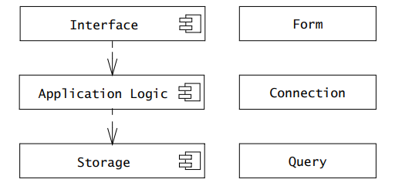
Breakdown of tabulationSystem

Slide 4
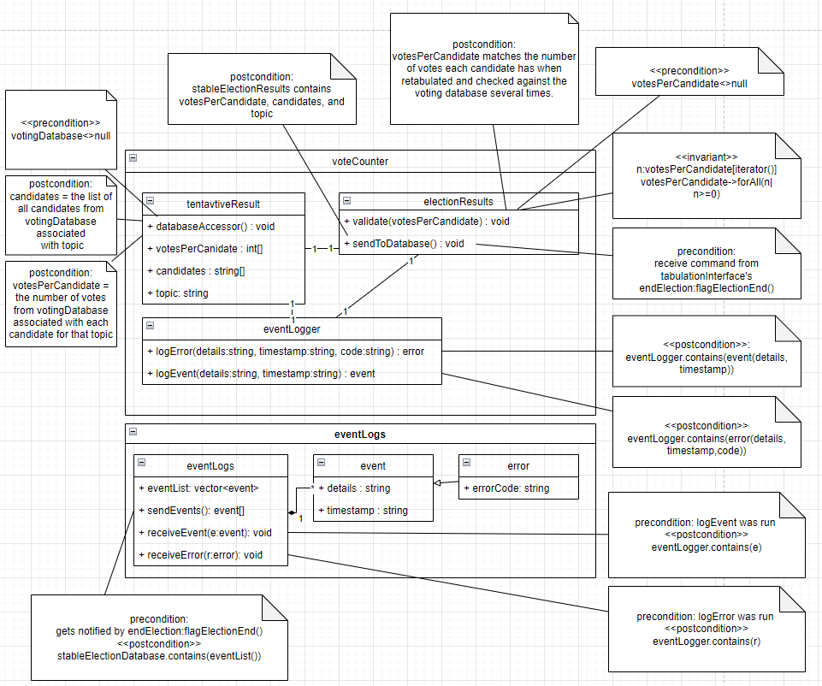
Breakdown of voteCounter

Slide 5
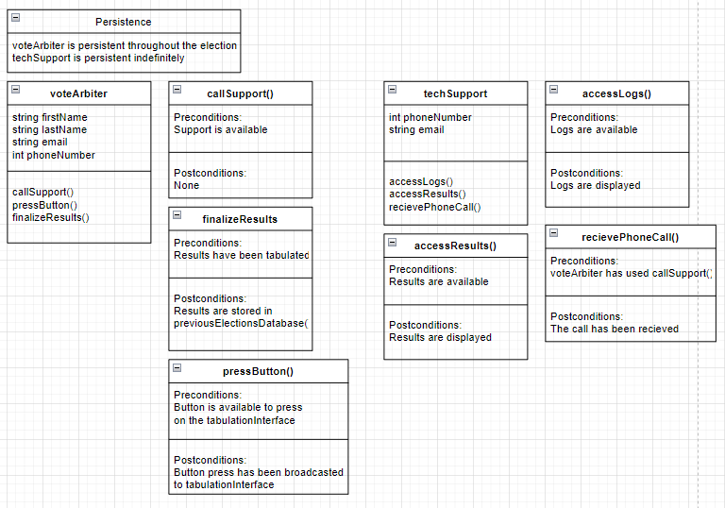
Breakdown of voteArbiter and techSupport

Slide 6
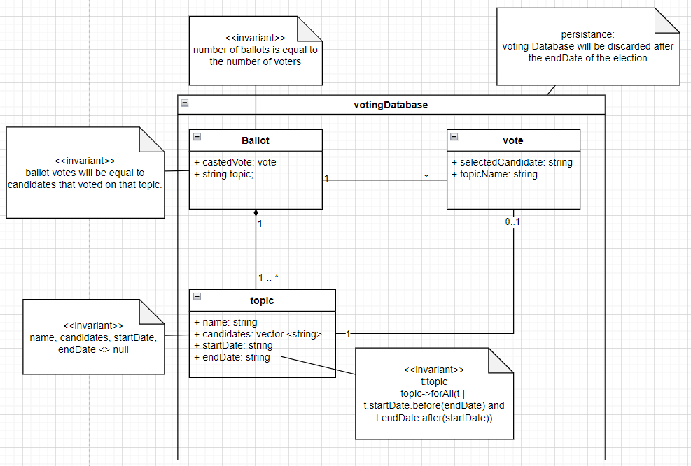
Breakdown of votingDatabase

Slide 7
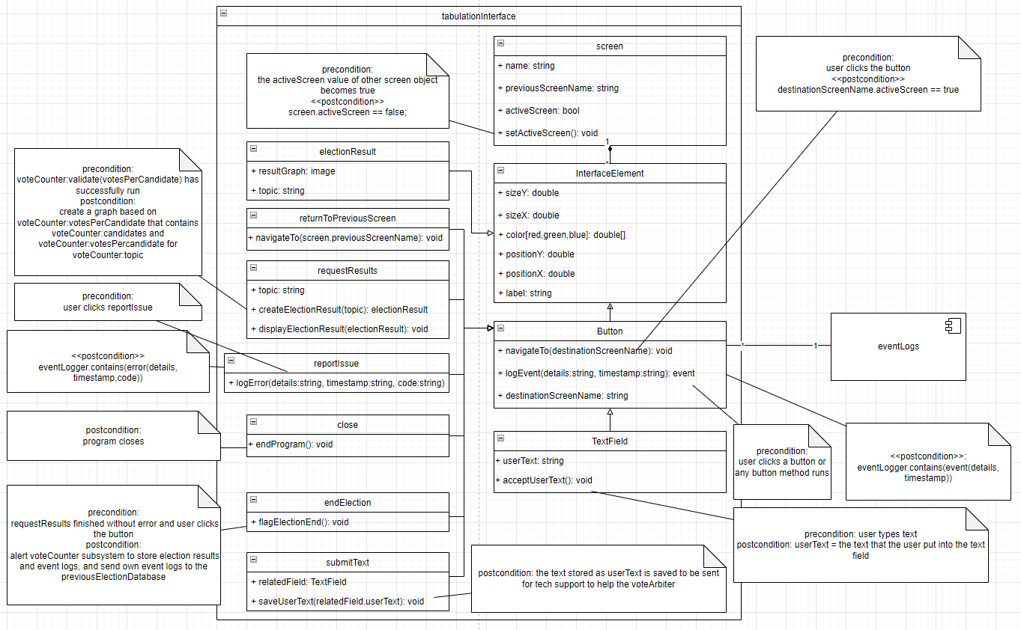
Breakdown of tabulation
interface

Slide 8
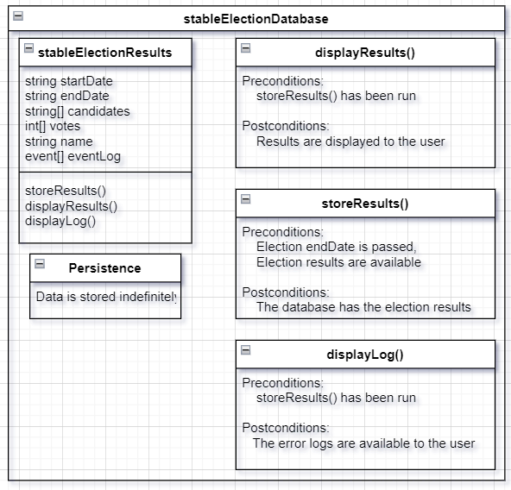
Breakdown of stableElectionDatabase

Slide 9
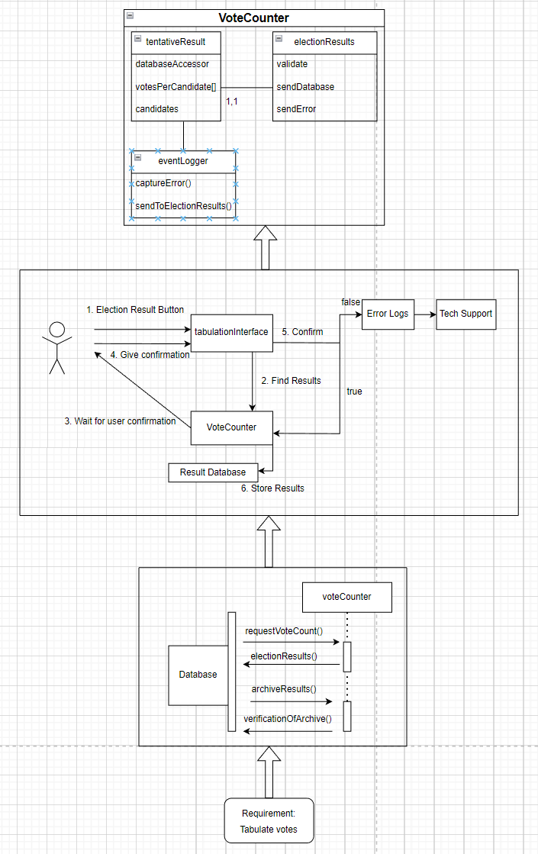
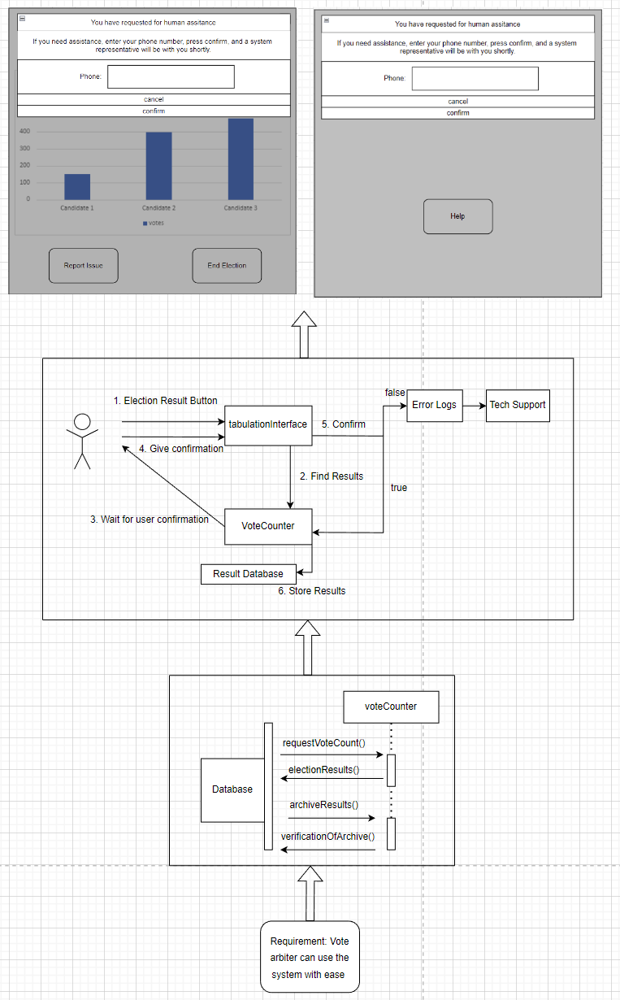
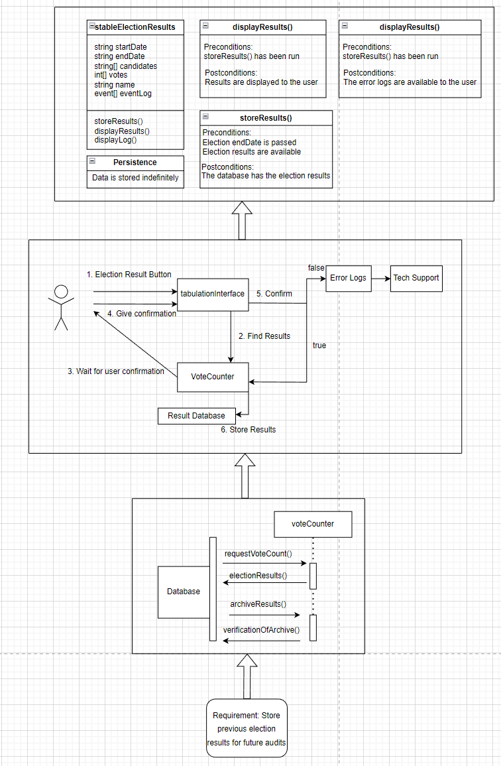


Traceability (Dependency Tree)
Requirement: Store Previous Election results for future audits
Requirement: Tabulate Votes
Requirement: Interface for user to interact with.

Slide 10
End

Slide 11
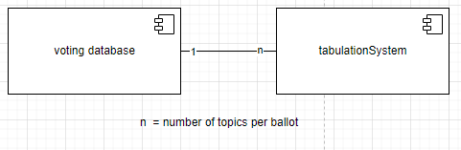

Slide 12
For Reading the image in the previous slide
The Requirement of tabulating votes caused the creation of the Vote Counter as shown in the sequence diagram in the analysis model this then leads to the vote counter being used in the collaboration diagram this lastly create the vote counter Object with its specific pieces in its object design.

Slide 13
For reading image in previous slide
The requirement of having a interface in which the user can interact with caused the creation of the tabulation interface in the sequence design model of analysis. This in turn lead to the collaboration model shown with the system design and lastly the object design of Tabulation Interface.

Slide 14
For reading images in previous slide
The requirement to have a way to store election results that can be audited in the future caused the creation of the results database as shown with the analysis using a sequence model. This then used as election results database as shown with the collaboration model in system design. Lastly the name is changed to previous election database as its parts is shown with the object design.

